Slide 1
Sakai Developer School
Dr. Charles Severance, University of Michigan
Sakai PMC Chair
Learning Experiences

Slide 2
AGENDA
Onboarding Sakai Developers
The Path to the Master Programmer
Sakai's QA Efforts
Developer School
Mentor Meetings
Future Thoughts

Slide 3
Onboarding Sakai Developers
In 2004-2006, our developer community grew by adding experienced senior developers
There were both talented and opinionated
Competing views on architecture
Onboarding was, "Here is the SVN url and README."

Slide 4
Computer Science Senior Projects
It would seem like getting 4-6 CS Seniors to work on Sakai for free was a good idea
Limitation – 15 weeks while taking other classes and interviewing
With so much talent, they wanted to tackle an impressive problem

Slide 5
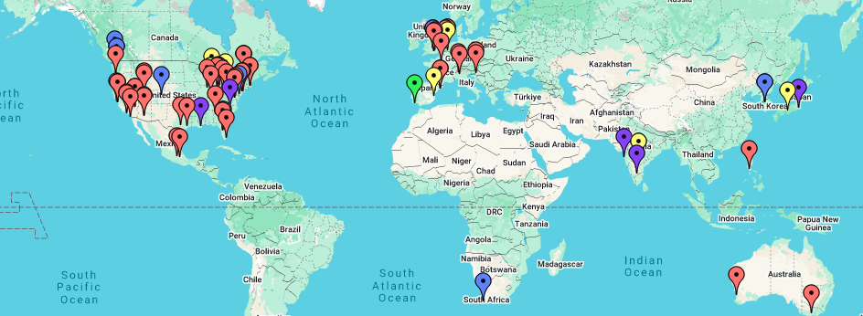
Dr. Chuck Coursera Worldwide Office Hours
https://www.dr-chuck.com/office/

Slide 6
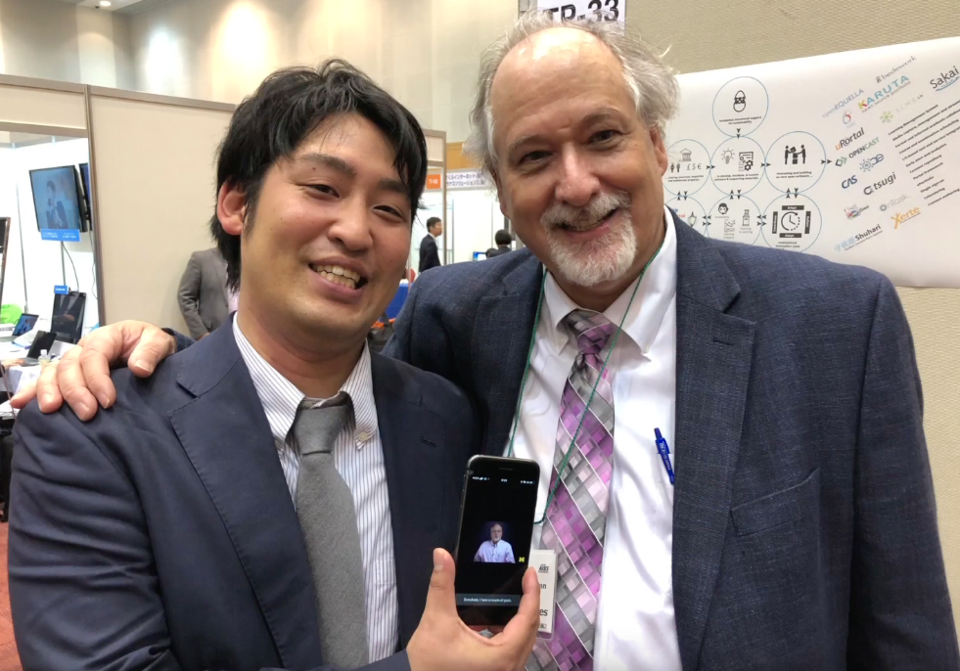
How do I get a Job?
Over 80 events around the world
The #1 question is, "How do I get a job?"
From 2013-2018, my answer was, "Go to Meetups."

Slide 7
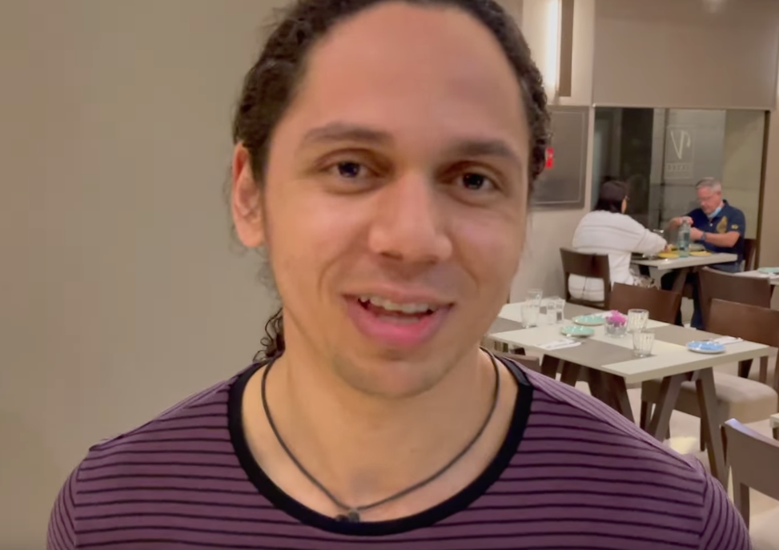
How do I get a Job?
March 2022 my first post-Covid office hours were in Valencia
The, "Get a job" question hit me much harder.
I vowed to find a way to directly impact job my student's job prospects

Slide 8
The Path to the Master Programmer
Would I hire students who took all my classes?
Who would I hire?
What is it that has made me a decent and valuable programmer?
Internet History
Python for Everybody
Django for Everybody
Web Applications for Everybody
PostgreSQL for Everybody

Slide 9
A good programmer is not about they already "know", it is their ability to learn new things.

Slide 10
A master programmer needs mentors. The best mentors will invest time if there is a cost / benefit.

Slide 11
A Pre-Mentorship Curriculum
Internet History
Python for Everybody
Django for Everybody
Web Applications for Everybody
PostgreSQL for Everybody
C Programming for Everybody
Hardware for Everybody
JavaScript for Everybody
Java for Everybody
Capstone Practical Experience

Slide 12
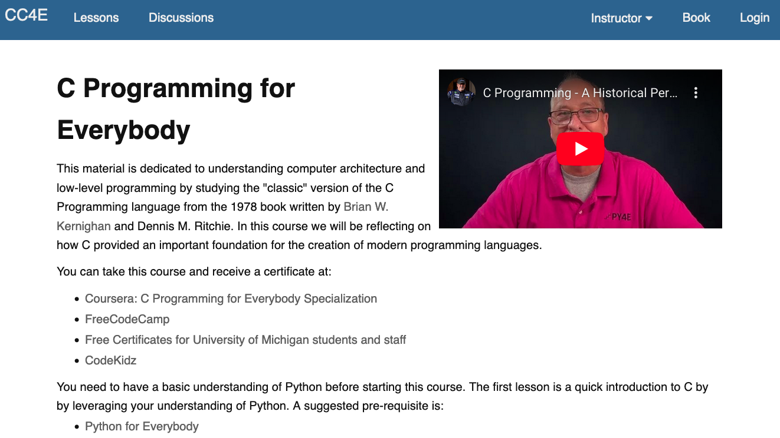
www.cc4e.com

Slide 13
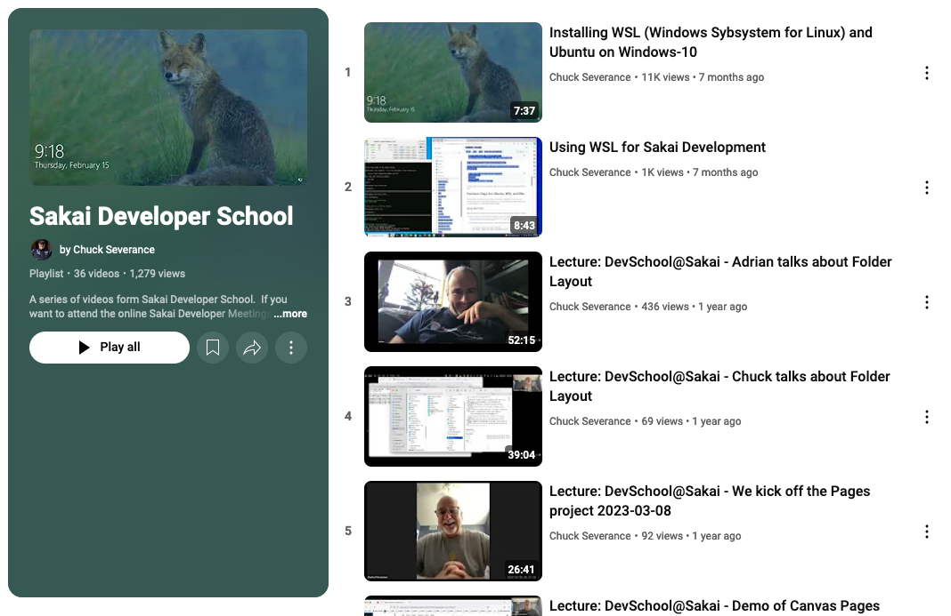

Slide 14
Onboarding Process
New people start in QA to learn the product, learn issue tracker, learn development process
At some point based on their skills and experience they take their first steps into bug fixing
And it goes on from there
Those were mentored are great mentors to the new members of the group
Wednesdays at 9:30 AM on Zoom

Slide 15
Future Ideas
Bring in CS Undergraduates interested in "the real world"
Bring CS project teams
Redo the developer school videos now that we have done it once
Chuck needs to make more classes so Coursera can be a source of new developers
It would be cool to get some funding – these positions need some level of pay

Slide 16
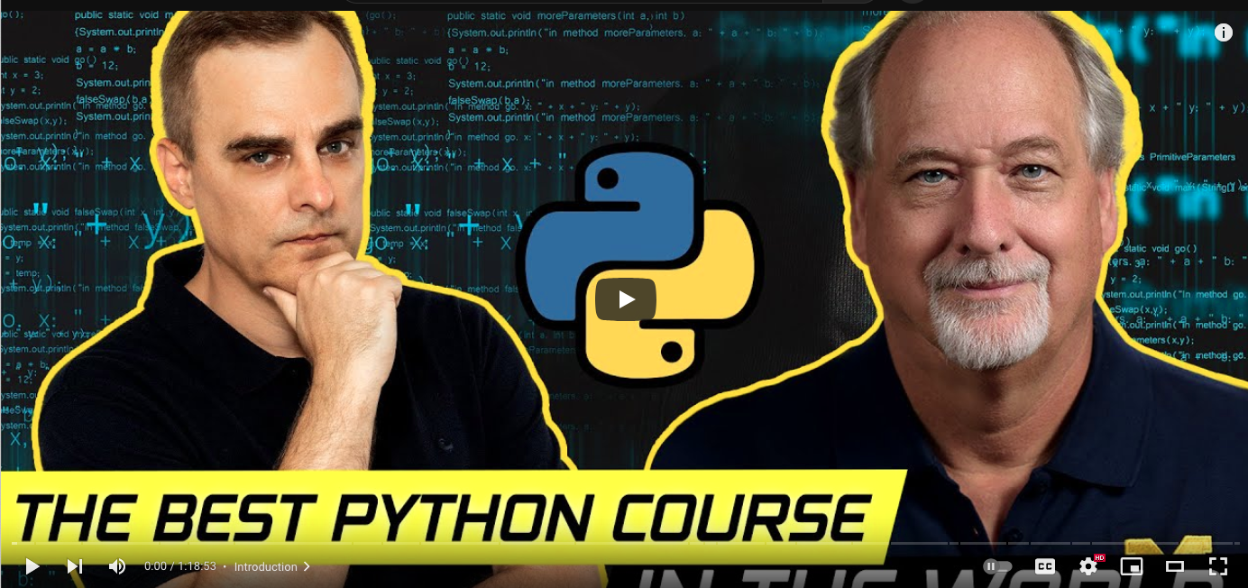
David Bombal podcast - Master Programmer
https://www.youtube.com/watch?v=z3o6yEzcnLc

Slide 17
Summary
Create a sustainable way to extend our community
Benefit goes both ways
This is just our first prototype of dev/school and mentor structure
Build out the Master Programmer Curriculum
Future – Connect Coursera Graduates and Sakai as example for other projects

Slide 18
THANK YOU
Adrian Fish
Mark Golbeck
Sharadhi Ragauraj
Shivangi Kuman
Kunal Jayakam
Zhuo Yang
Prithvijt Dasgupta
Chris Knapp
Matt Jones
Charan Epuri
Dr. Charles R. Severance
csev@umich.edu
www.dr-chuck.com

